Slide 1
Online Hospital’s fetching
Project by..
k.Lavanya. Email:lavanyalaav1234@gmail.com
M.Divya. Email:manduva.divyanaidu@gmail.com
k.vimala. Email:vimalareddy.sai@gmail.com

Slide 2
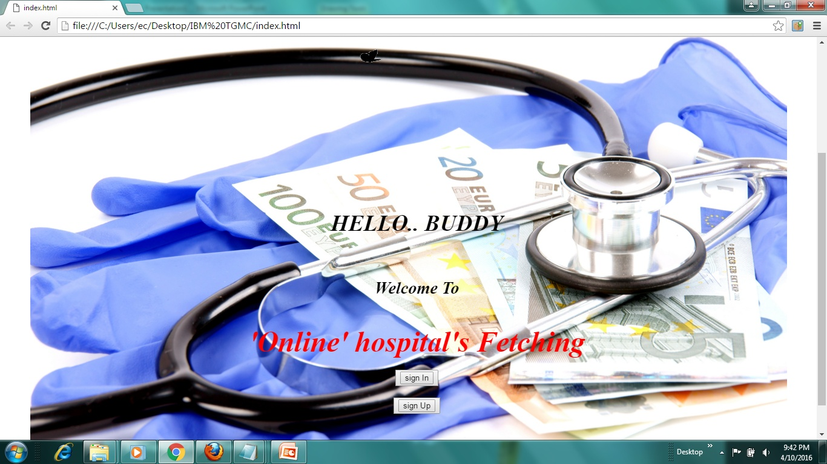
Index:

Slide 3
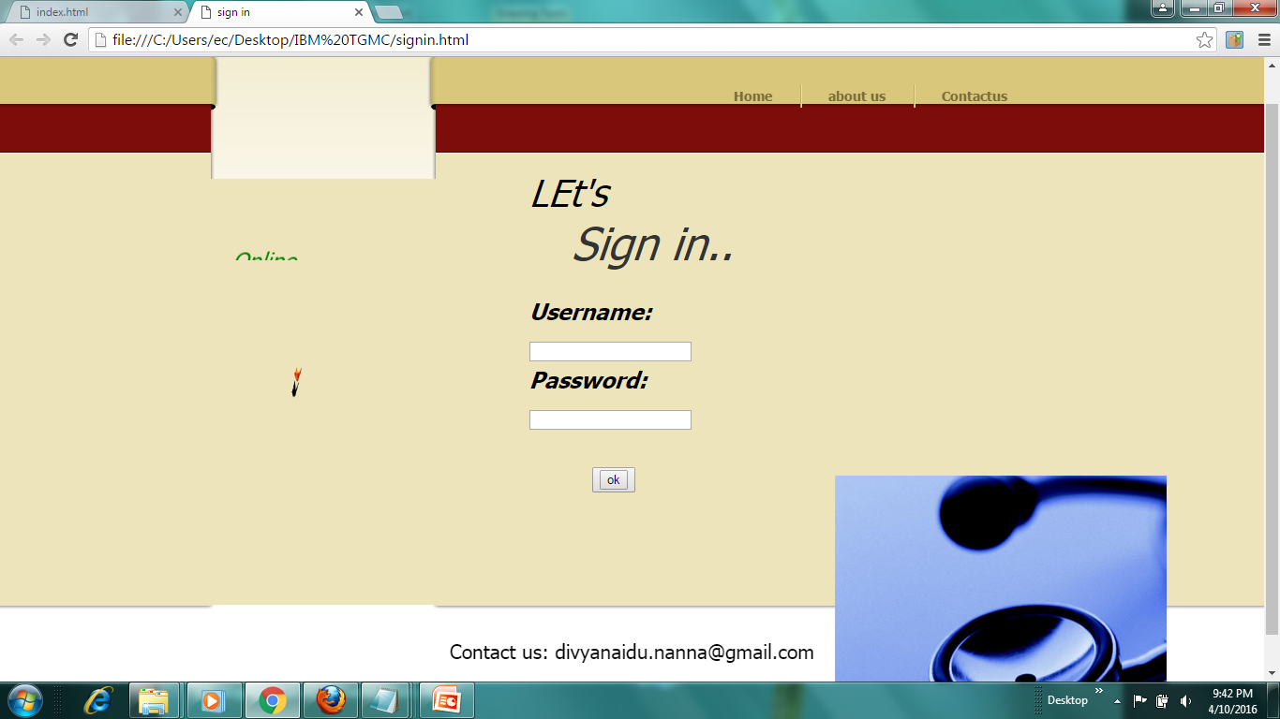
Sign in:

Slide 4
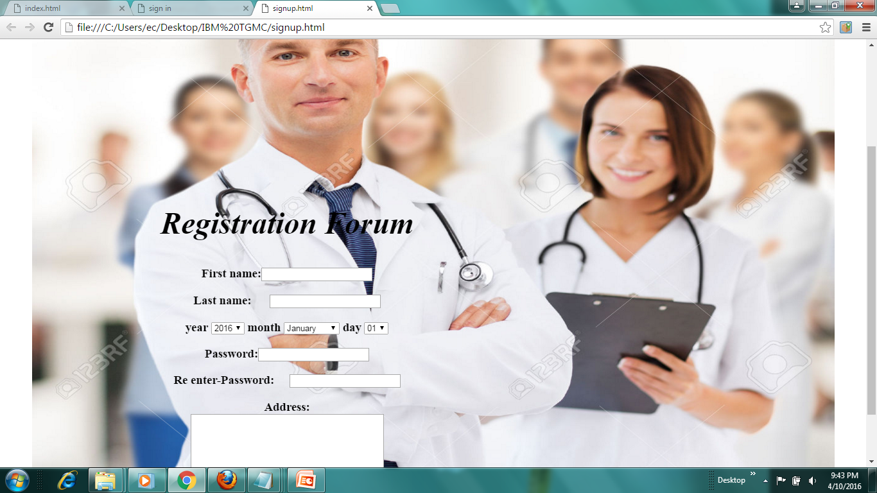
Sign up:

Slide 5
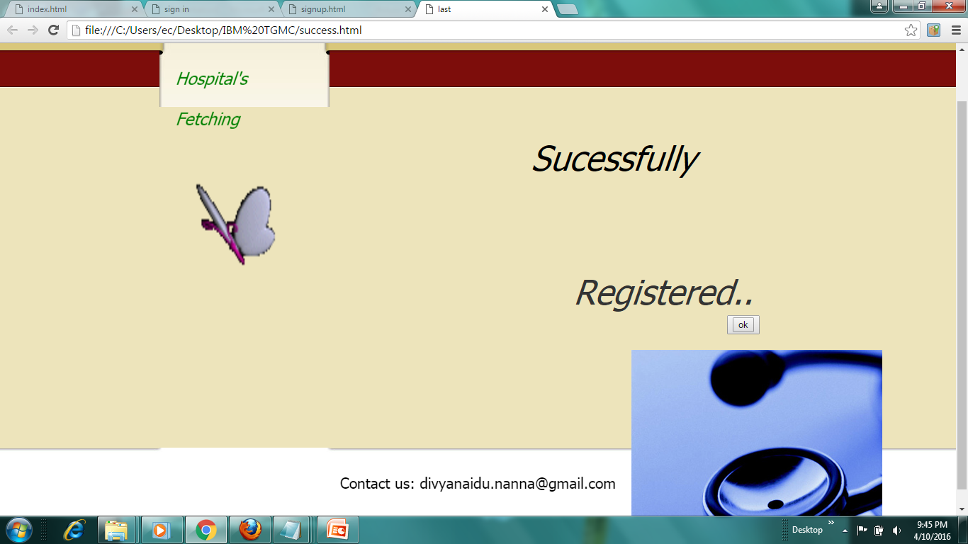
If signed up:

Slide 6
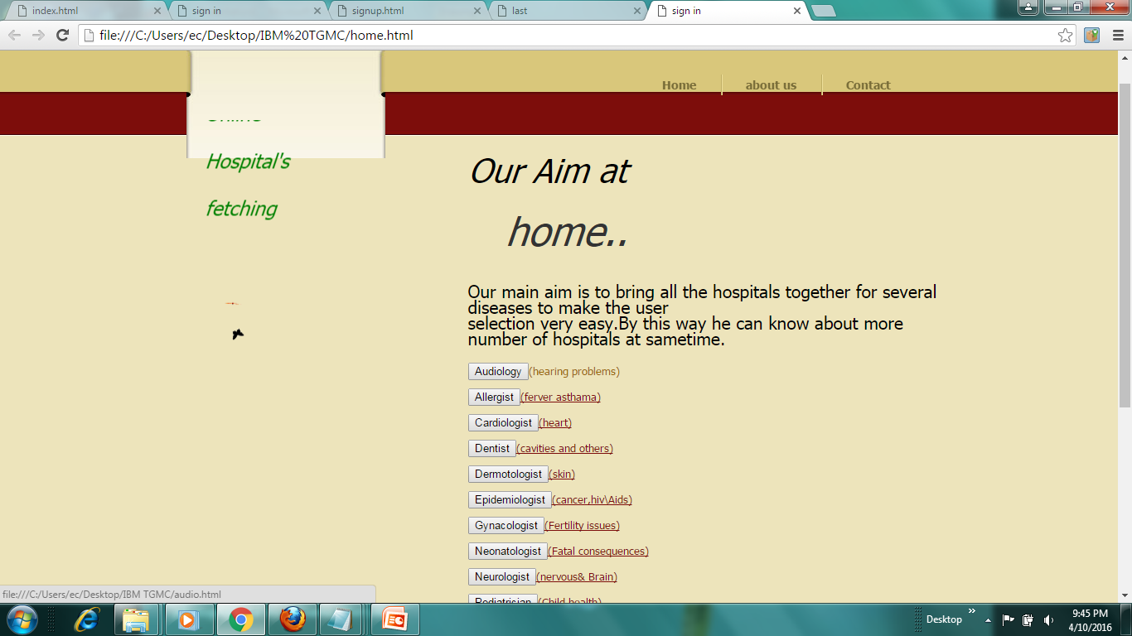
Home:

Slide 7
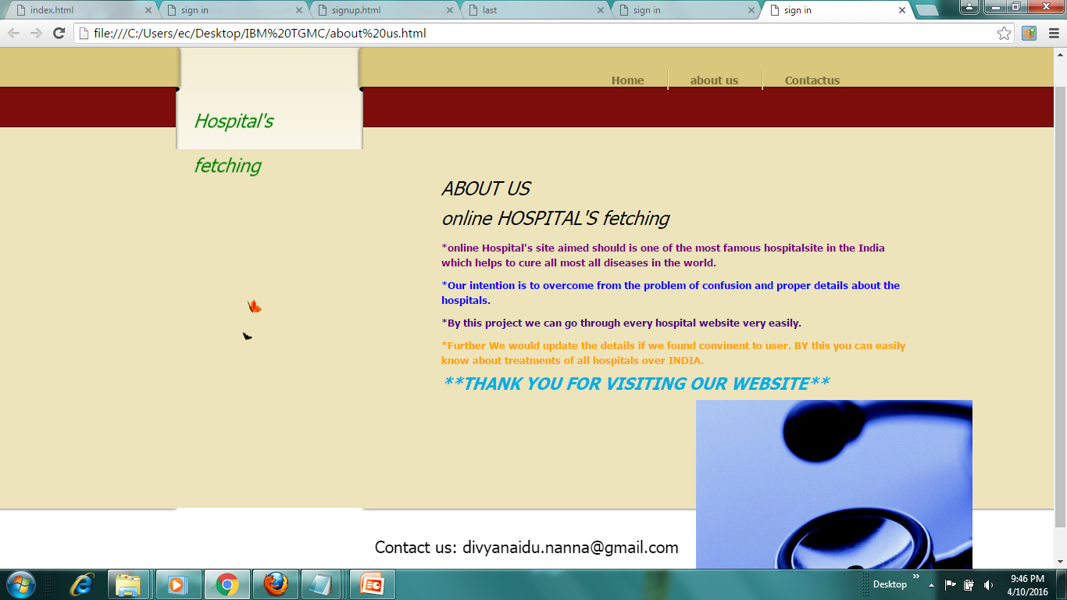
About us:

Slide 8
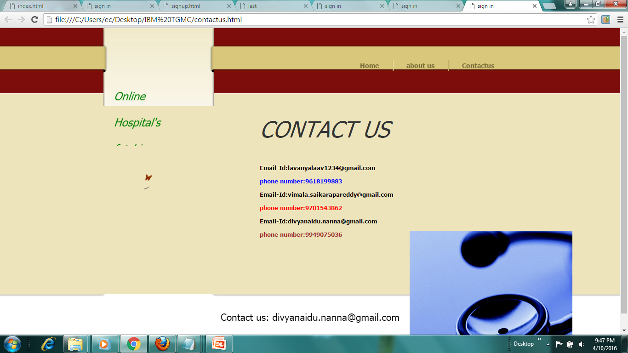
Contact us:

Slide 9
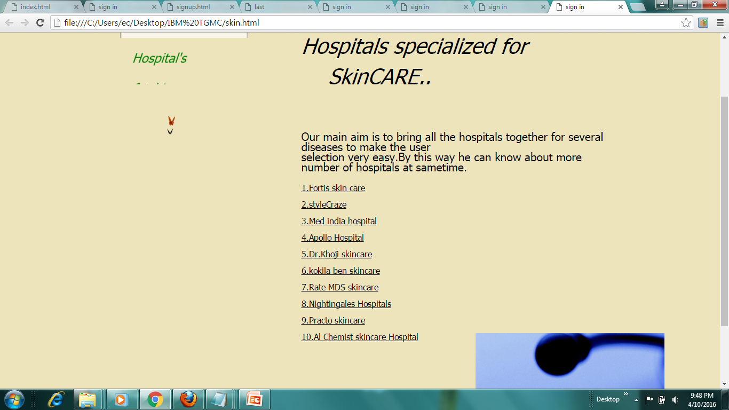
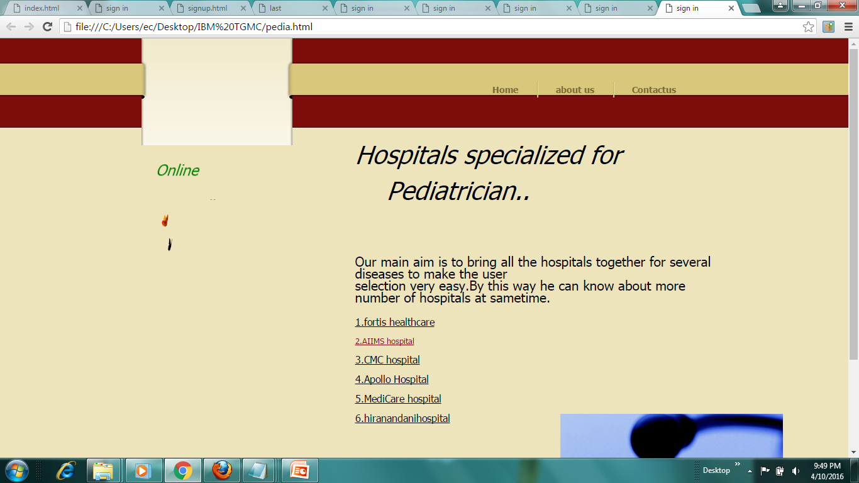
Several hospitals:

Slide 10
Any QUERIES??

Slide 11
Thank you..

